Slide 1

TEAM : HACK 07
G.L BAJAJ INSTITUTE OF TECHNOLOGY AND MANGEMENT
B.TECH 2nd YEAR
[COMPUTER SCIENCE & ENGINEERING]
PRESENTED BY:
AYUSH GUPTA
APARNESH SHUKLA
ARUN SHANKAR
PRANJAL DUDEY
BITTHAL VERMA

Slide 2
PROBLEM STATEMENT :
Increased use of public transportation can help reduce air pollution and the health benefits that accompany it. Public transportation produces far fewer quantities of air pollutants.
Today travelling through public transport in city became a hectic job.
Commuter doesn’t get any idea of current location of bus or exact timing of arriving bus.
So, commuter have to wait for a bus-on-bus stop for several minutes sometimes hours. Spending such valuable time on bus stop without knowing any information of bus is not acceptable at all.
Traveler must be aware about upcoming buses timings or location on bus stop.
So that he/she can plan further activities according to time required for travelling.

Slide 3
Overview to Solution
We will provide a website for the user to easily find out a bus or public transport as per convenience. Some highlights are:
Arrival and departure time of bus at each stoppage.
Buses that are going through particular route : User just need to type the Timing or Stoppage and we provide bus available on that route.
Live location of each bus : We will update arrival time or departure of every stoppage based on current live location, if there is traffic in between or any other delay it will be updated on the website.
We will provide list of buses based on the pick up location and destination location.

Slide 4



Information – flow Diagram :
1
A.T./D.T. of Bus sent on server via Network
3
2
Data sent to User
User Request

Slide 5
Information – Flow Diagram Steps :
The module (GPS) set in Bus generates the data respective of the bus location.
The data then forwarded through wi-fi embedded in the module and shared to the server through help of Internet.
User access the Information with their browser.

Slide 6
Explained Steps :
The fundamental process in our system is obtaining Bus for user on using GPS technology with Previously decided Arrival and Departure Time.
Transmitting the data via network to the central control unit for data processing and information analysis and to take appropriate decision.
The position data is periodically send to the central server through the transmitter of the module.
The server automatically updates the data base with latest position.
The GPS receiver of the unit is capable of identifying the latitudinal and longitudinal position and ground speed of the specific Bus by receiving information from the GPS satellites.
As the User requests to server for the information on the website, the date for the respective bus is represented to the user.

Slide 7
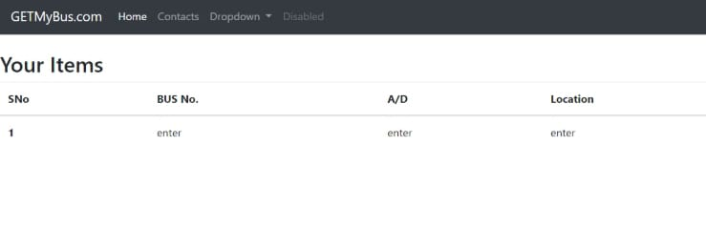
Our Implementation (Prototype)
User End

Slide 8
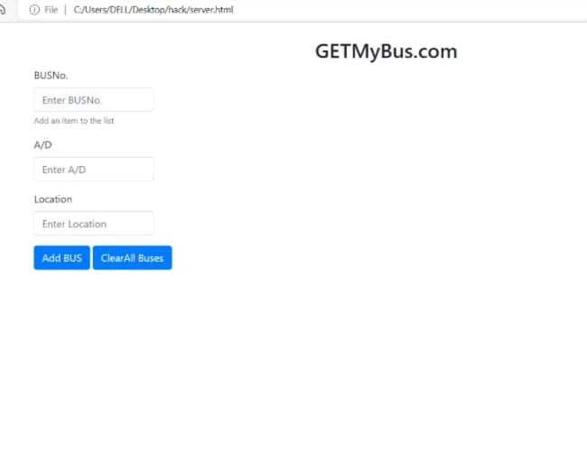
Server End

Slide 9
Conclusion:
Now we have resolved the issue for the user of not getting the Arrival and Departure time through our idea.
Which will reduce the waiting time for user’s and save his/ her valuable time.
And this will help user to use his/ her time for scheduling needs and activities.

